Slide 1
Introduction to Tensorflow
Gabriella Miles (gabriella.miles@bristol.ac.uk)

Slide 2
Aims and Objectives
What is Tensorflow, and what can it be used for?
Implement models using the Keras Functional API
Understand how to train and evaluate model performance
Review the workbooks to gain a greater understanding of how to improve model performance
Improving model architecture
Data augmentation

Slide 3
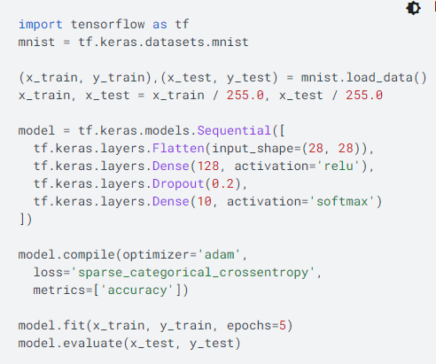
What is Tensorflow?
End-to-end platform for machine/deep learning
Massive range of built in datasets: a list here
Different tasks:
Image classification (MNIST etc)

Slide 4
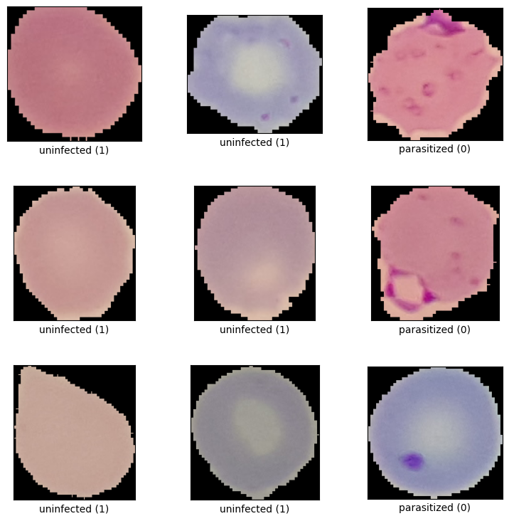
Malaria Dataset
Link to dataset at the National Library of Medicine: here
27,558 cell images from the thin blood smear slide images of segmented cells.
Two classes:
Uninfected cells (1)
Parasitised cells (0)

Slide 5
What is a deep learning model?
“Deep learning/network” is a vague term
No particular cutoff for when a network becomes a “deep network”
Model that takes an input, runs some calculations, and produces an output

Slide 6
What is a deep learning model?
Input: receives initial data/features
Raw or handcrafted
Hidden: intermediary layers between input and output
Apply mathematical operations on received input
Extract and learn hierarchical representations of the input data
Output: provides final results/predictions
Task dependent

Slide 7
What is a deep learning model?
Connections between layers are determined by network architecture
Fully connected
Convolutional
Pooling

Slide 8
Building models

Slide 9
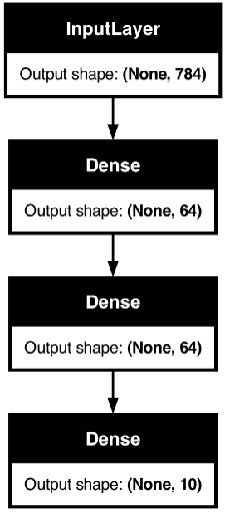
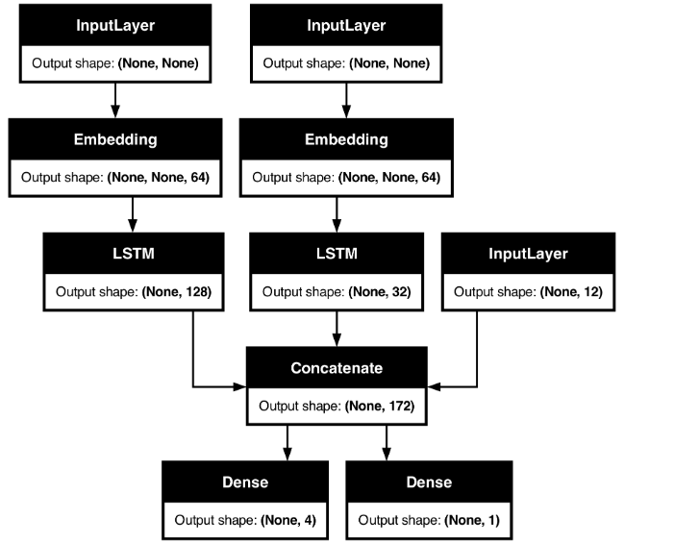
Building and instantiating models
Keras Sequential API
Keras Functional API

Slide 10
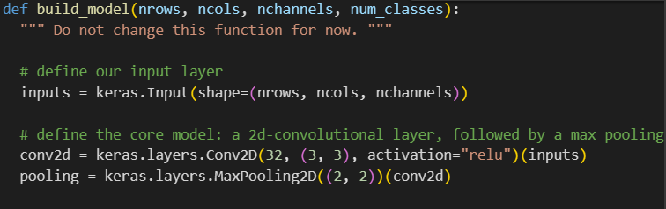
Layers
Module: here
Fully-connected
Convolutional
Pooling
Dropout

Slide 11
Training the model

Slide 12
What is a deep learning model?
Forward pass
Make predictions
Calculate loss
Compare network output to ground truth
Backpropagate through the network to minimise the loss function
Change weights and biases

Slide 13
Training a model
Training/validation/test sets
Compiling the model, choosing the optimiser

Slide 14

Training/validation/test sets

Slide 15
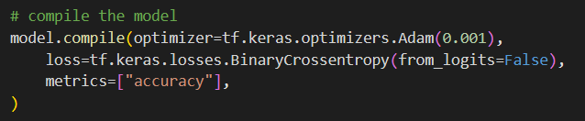
Compiling the model, choosing the optimiser
Need to specify:
Optimiser
Loss function
Metrics
Range of optimisers to choose from, see list here

Slide 16
Loss functions, and metrics for classification
 | Binary Crossentropy | Sparse Categorical Cross Entropy | Categorical Cross Entropy
Number of classes | 2 | More than 2 | More than 2
Label format | Integer (0 or 1) | Integer labelled (0, 1, 2, 3…) | One-hot encoded [0, 0, 1] [1, 0, 0] [0, 1, 0]
Metrics | Accuracy? | Top K Categorical Accuracy?

Slide 17

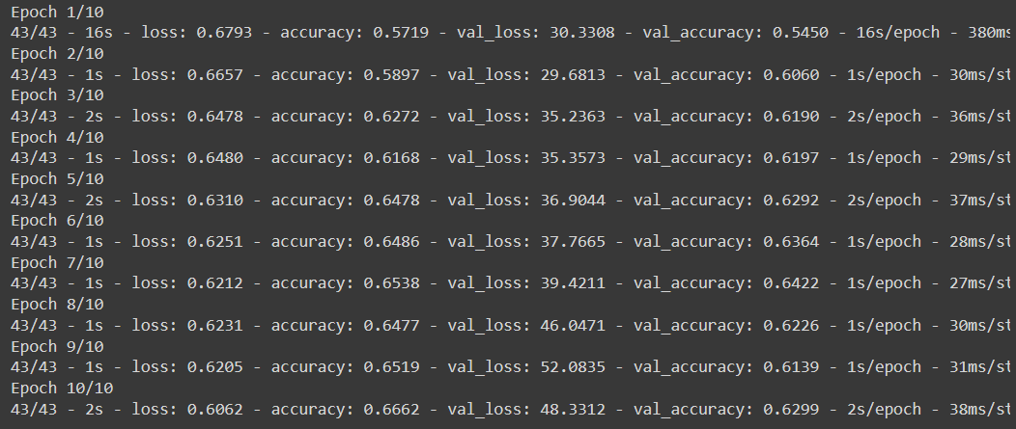
Training a model

Slide 18
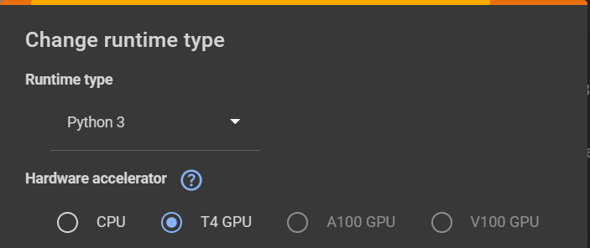
Exercise
Malaria dataset
MNIST dataset (summer school)
https://colab.research.google.com/drive/1PJON9_tZ_Ghiid2WXHuQDs6ByCE9fKzP?usp=sharing
https://colab.research.google.com/drive/12uu5X36j89x09wCAWxZVaXIjA365UnP5?usp=sharing
Extremely useful deep learning resources:
A Recipe for Training Neural Networks
Machine Learning Mastery

